Slide 1
Jermyn Borough Council Meeting
07/11/19

Slide 2
Meeting Agenda
Call to Order
Pledge of Allegiance
Moment of Silence for Former Junior Councilperson Brian Swatt Jr.
Roll Call
Previous Meeting Minutes
Treasurer’s Report/Bills Payable
Correspondence
Public Comment
Reports
Reports of Committees
Woodlands Sewer, Paving Issue
Bid Opening for DPW Pole Building
Employee Handbook/PTO Policy
Alleyways, Paving Referendum
Rushbrook Creek Update
Garbage Contract Bidding Advertisement
Executive Session – Personnel
New Business
Adjournment

Slide 3
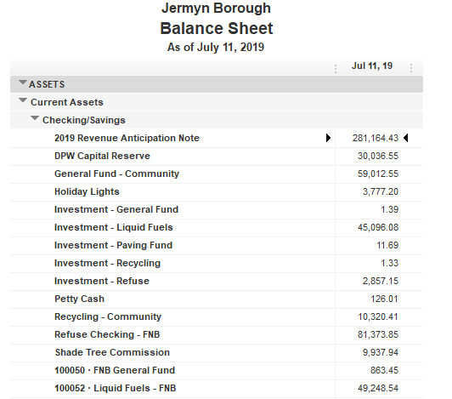

Treasurer’s Report

Slide 5
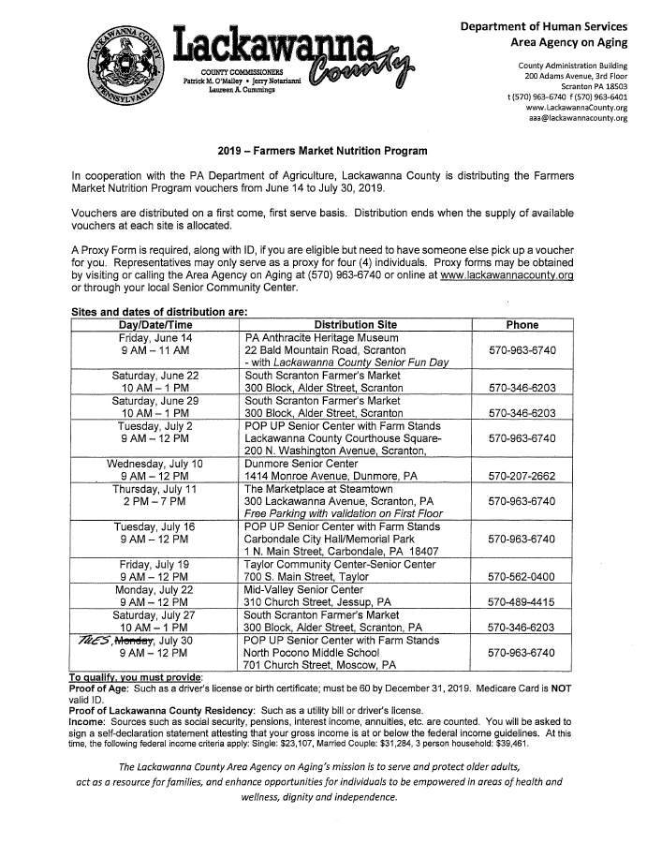

Slide 6
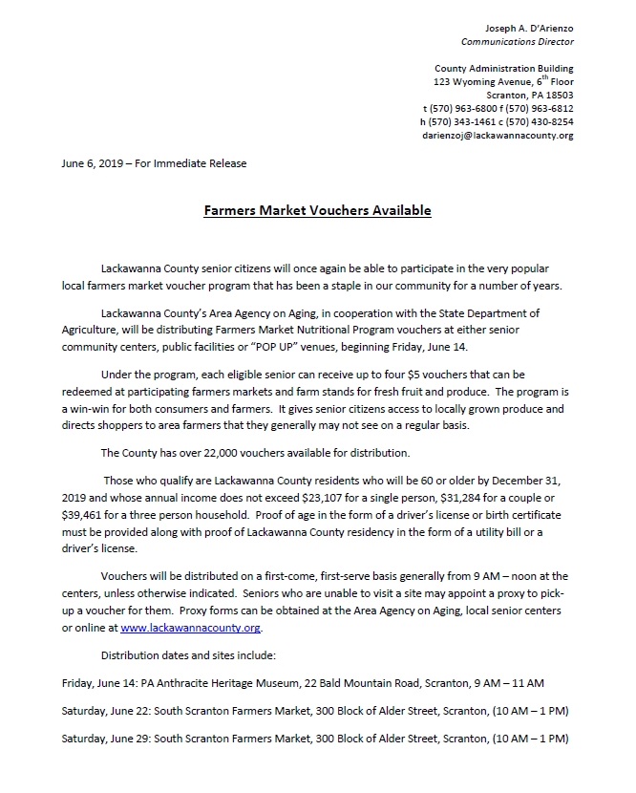

Slide 7
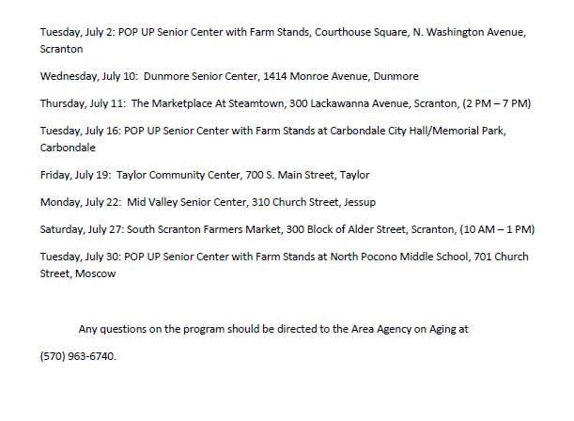

Slide 8


Slide 9


Slide 10


Slide 11


Slide 12


Slide 13


Slide 14
Stormwater Pollution The Dirty Truth: Home Activities

Slide 15
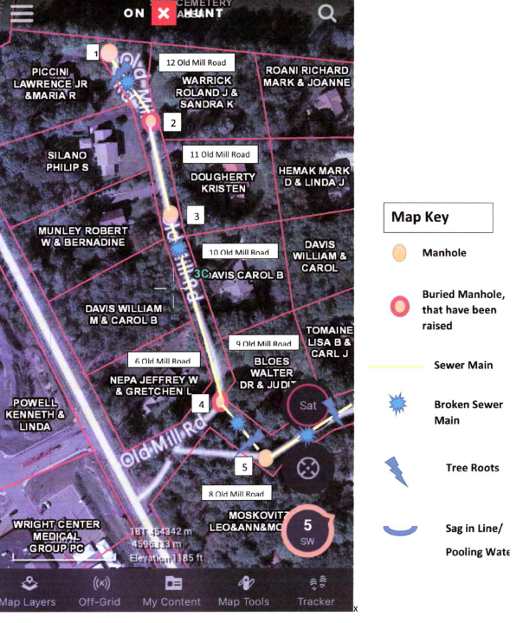

Slide 16
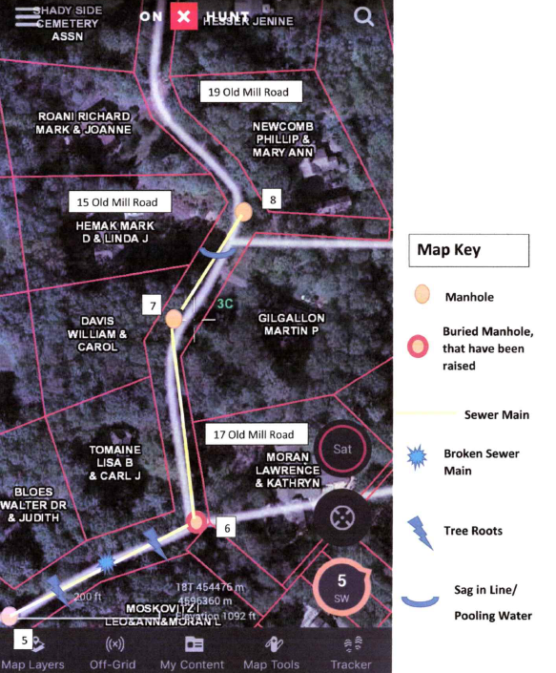

Slide 17
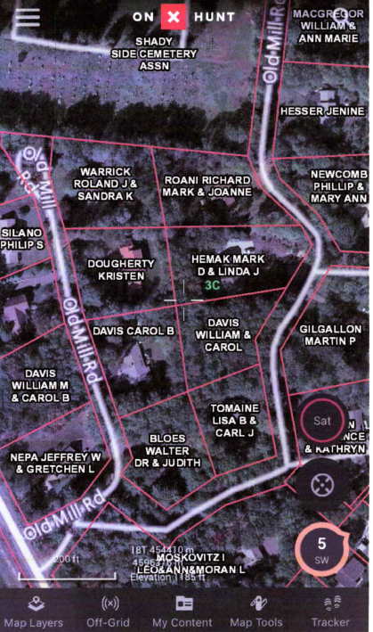

Slide 18
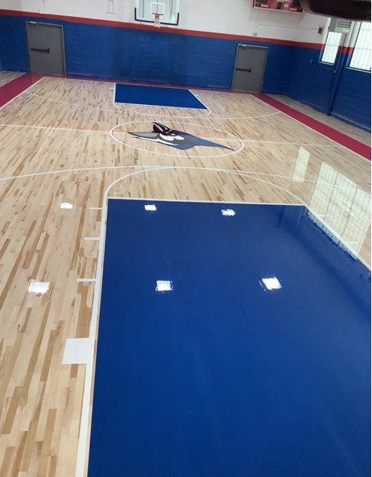

Slide 19
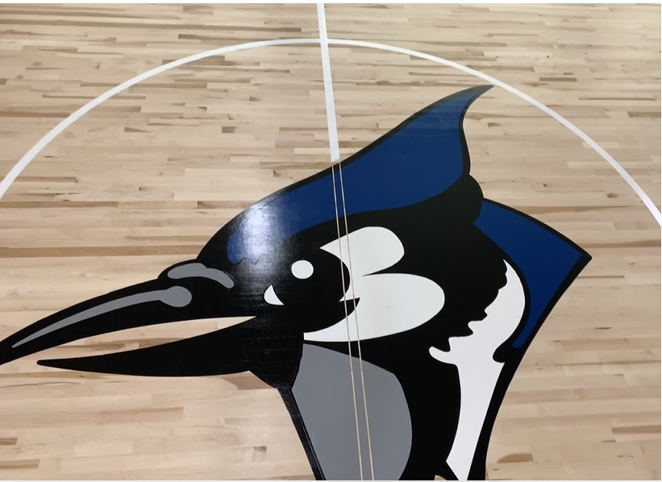

Slide 20
